Slide 1

Python Inter-Process Communication
R. Naga Leela Krishna

Slide 2
Introduction
Thread : is a thread of execution in a program. Aka, lightweight process.
Process : is an instance of a computer program that is being executed.
Thread share the memory and state of the parent, process share nothing.
Process use inter-process communication to communicate, thread do not.

Slide 3



Concurrency
Python has three concurrency modules :
Thread
Threading
Multiprocessing

Slide 4
Thread :
Provides low-level primitives for working with multiple threads.
Python first implementation of thread, it is old.
Not included in Python 3000 .
Threading :
Construct higher-level threading
interface on top of thread module.

Slide 5
Multiprocessing
Multiprocessing :
Supports spawning process.
Offer local and remote concurrency
New in python 2.6.
Solves the issue in the threading module.

Slide 6
Why new module?
Python Global Interpreter Lock, GIL, limitation prevents a true parallelism in multi processors machines.
What is GIL ?
Lock which must be acquired for a thread to enter the interpreter‟s space.
Lock assures that only one thread executes in the cPython VM at a time.

Slide 7
How GIL works ?
It controls the transfer of control between threads. Python interpreter determine how long a thread‟s turn runs, NOT the hardware timer.
Python uses the OS threads as a base but python itself control the transfer of control between threads.
For the above reason, true parallelism won’t occur with Threading module.

Slide 8
“Nevertheless, you„re right the GIL is not as bad as you would initially think: you just have to undo the brainwashing you got from Windows and Java proponents who seem to consider threads as the only way to approach concurrent activities “, Guido van Rossum.

Slide 9
Multiprocessing VS Threading
Lets see the problem in action. I analyzed the code that was written by Jesse Noller in depth.
I used cProfile and pstats modules to gain an idea of how the code was handled by Python.
I‟m testing the program in Quad-Core machine, 8 CPU‟s.

Slide 10
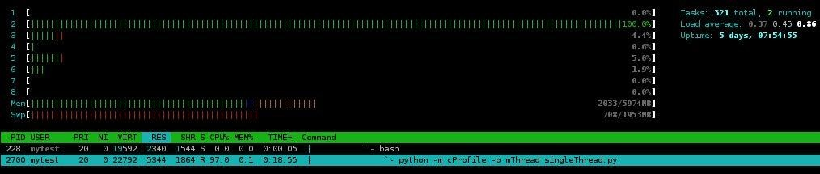
The program took 52.810 CPU seconds.
Single Thread :
– The program took 52.810 CPU seconds.

Slide 11
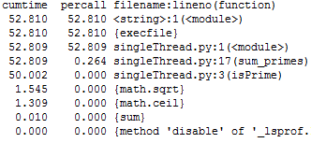
Most of the time, it was executing isPrime, sum_primes functions.

Slide 12
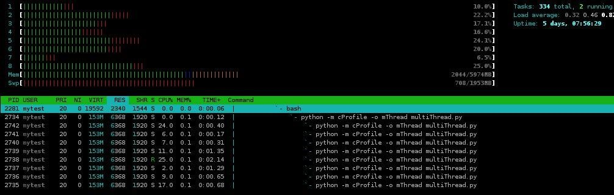
Multi Threads :
The program took 59.337 CPU seconds. This is more than what it took the single version of the same program !

Slide 13
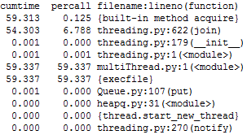
Most of the time was used by a built-in method acquire !

Slide 14
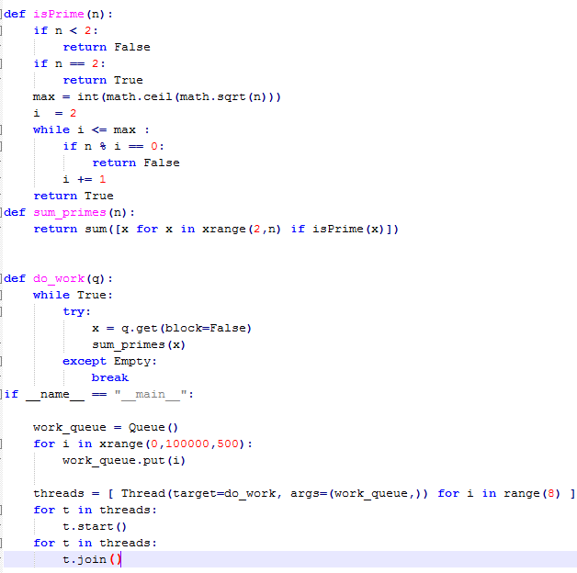
Wait ! Built-in method ? Threading acquire method was not in the code.

Slide 15
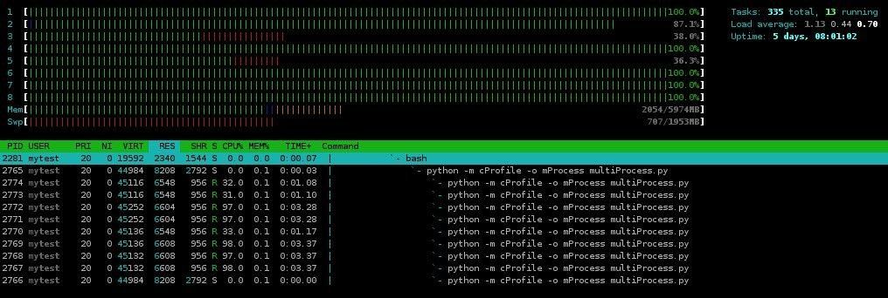
Built-in acquire ! This must be the GIL.
Multi processes :
– Took only 11.968 seconds. ~ 5 times faster !

Slide 16
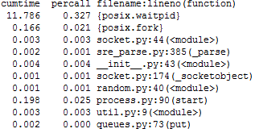
Most of the time was spent in waiting for other processes to finish.

Slide 17
So, How does multiprocessing module solve the problem ?
It uses subprocesses instead of
thread.
Therefore, it allow the programmer to fully leverage multiple processors on a given machine.

Slide 18
Differences between threading / multiprocessing syntax ? Almost the same.
Threading :
Thread(target=do_work,args=(work_queue,))
Multiprocessing:
Process(target=do_work,args=(work_queue,))

Slide 19
Multiprocessing Module
Remember :
Processes share nothing.
Processes communicate over inter- process communication channel .
This was not an issue with Threading module.
Python developers had to find a way for processes to communicate and share date. Otherwise, The module will not be as efficient as it is.

Slide 20








Exchange Object between Processes
Multiprocessing module has two communication channels :
Communication channels
Queues
Pipes

Slide 21
Queues :
Returns a process shared queue.
Any pickle-able object can pass
through it.
Thread and process safe.
Pipes :
Returns a pair of connection objects connect by a pipe.
Every object has send/recv methods that are used in the communication between processes.

Slide 22
Queues simple example :
The program creates two queues :
Tasks : queue that has range of int.
Results : queue that is empty. It is used to
store results.
Then creates n workers, each worker get a data , number, from shared queue, multiply it by 2 and store it in the result queue.

Slide 23
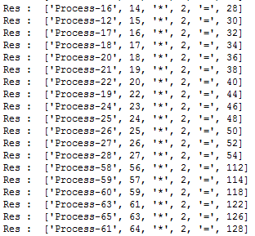
Exchange Object between Processes
Observation :
Result is not in order even if our tasks’ queue was in order. This is because the program run in parallel.
Queue.get() return the data to the worker and delete it.
Part of the output :

Slide 24
Sharing state between processes
Multiprocessing module has two ways to share state between processes :
Shared data:
1. Shared memory
2. Server process
Server process

Slide 25
Shared memory :
Python provide two ways for the data to be stored in a shared memory map:
Value :
The return value is a synchronized
wrapper for the object.
Array :
The return value is a synchronized wrapper for the array.

Slide 26
Server process:
A Manager object control a server process that holds python objects and allow other process to manipulate them.
What is Manager ?
Controls server process which manages shared object.
It make sure the shared object get updated in all processes when anyone modifies it.

Slide 27
Lets see an example of sharing state between processes :
The program create a Manager list, share it between n number of workers, every worker update an index.
After all workers finish, the new list is printed to stdout.

Slide 28
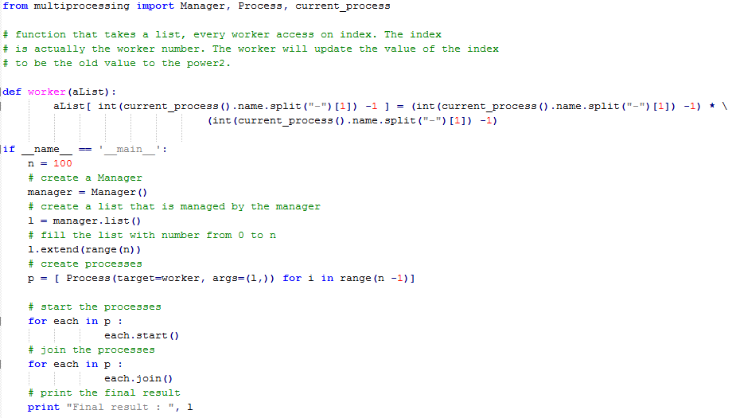
Server process simple example :

Slide 29
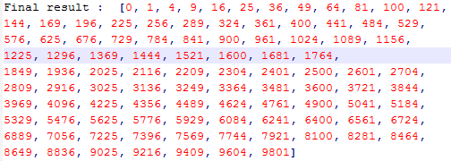
Observation :
We did not have to worry about synchronizing the access to the list. The manager took care of that.
all processes see the same list and act on one shared list.
Result when n = 10000 :

Slide 30
Pool of worker
Multiprocessors module has a Pool class that :
Distribute the work between
worker.
Collect the return value as a list.
You do not have to worry about managing queue , processes, shared date/stats yourself.
It makes it easy to implement quick/simple concurrent program.

Slide 31
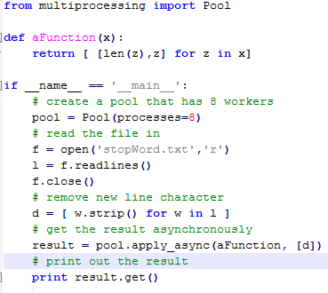
Program reads list of words from a file and returns a list of list where every list contains a word and its length.

Slide 32
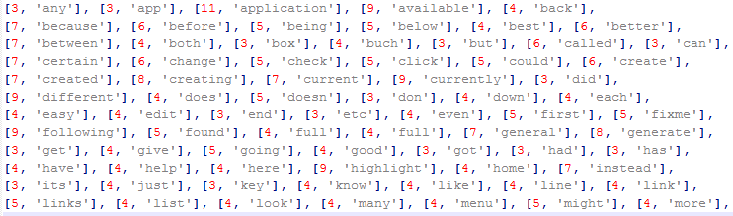
Observation :
– we did not do any work beside telling the program how many workers we want in the pool.
Part of the result :
It can not be easier than this ☺

Slide 33
Distributed concurrency
Recall that the Manager in multiprocessing module controls a server process that manages a share object.
That server can be accessed remotely and the shared object can be distributed to many clients. Whenever a client update the shared object, every other client will see the change.

Slide 34
To create the server :
Create a class that inherit BaseManager class.
Call the class method “register” to assign a name to what you want to share.
Define the address which your server will be listening on.
Call the function get_server and serve_forever to run the server.
To create the client :

Slide 35
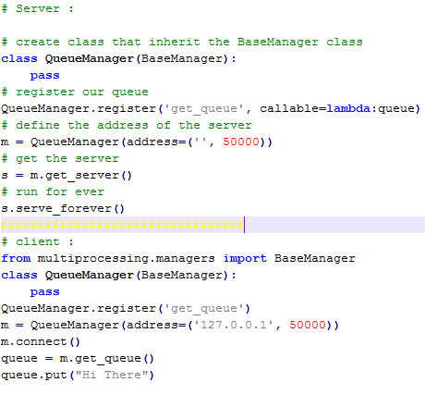
Register the name of the object that the server is sharing.
Connect to the server address.
Call the name of the shared object.

Slide 36
Conclusion
Multiprocessing module is a powerful addition to python. it solved the GIL problem and introduced easy way to achieve true parallelism.
Implementing a concurrent program is not easy, but with the way this module works, I think it makes the programmer job much easier.

Slide 37
References
https://docs.python.org/3/library/ipc.htmlwith Python” by Norman Matloff and Francis Hsu, University of California, Davis.

Slide 38
Thank you

